Slide 1
Review for Quiz – Statistics Math 210

Slide 2
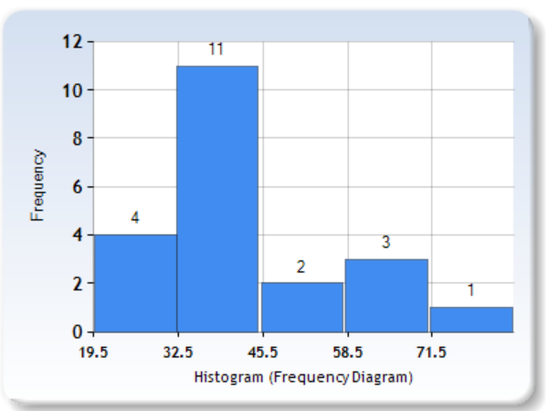
1. Given the following frequency histogram, find:

Slide 3
A) The sample size that was analyzed
B) What is the cumulative frequency of class 2?
C) What is the midpoint of class 3?
D) What is the class width?

Slide 5
2. It is estimated that 36% of the students are bored in their Statistics class. If a random sample of 15 students from this population is examined, find the probability that:
a) 3 students will say they are bored in class;
b) Fewer than 2 will say they are bored in class.
c) What is the expected value of students bored in their Statistics class?
d) What is the standard deviation for the number of students bored in their Statistics class?
e) At least 3 students will say they are bored in class

Slide 8
3. At a city high-school, past records indicate that the literacy test scores for students are normally distributed with a mean of 67% and a standard deviation of 12%. If one student is randomly selected, what is the probability that his score will be more than 70%?

Slide 11
4. For the following sample data below representing the amount of time (in hours) groups of students spent in completing a Statistics project, find: 5 7 12 8 8 12
a) The mean;
b) The median;
c) The midrange

Slide 12
d) The standard deviation; e) The 58th percentile;

Slide 13
5. For the data in the stem and leaf graph below, find:
A) First quartile; B) Third quartile; C) The interquartile range

Slide 14
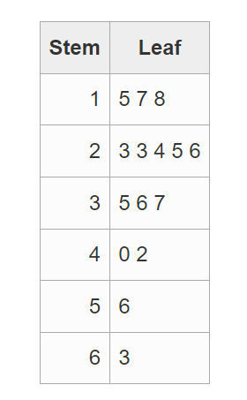
Key: 2I3 means 23 lbs.

Slide 17
6. The height of trees in a nursery is normally distributed with a mean of 45 cm and a standard deviation of 15 cm. Find:
a) The probability that a tree will have a height above 40 cm
b) The probability that a tree will have a height below 40 cm.
c) The height that separates that top 10% of the heights from the rest
d) The height that separates the bottom 15% from the rest
e) The 87th percentile

Slide 21

Question 7
8. For the following bivariate data, find the regression line: $\hat{y}= b_{0}+ b_{1}x$
x | y
21 | 12
34 | 11
35 | 9
46 | 9
47 | 6
73 | 4

Slide 22
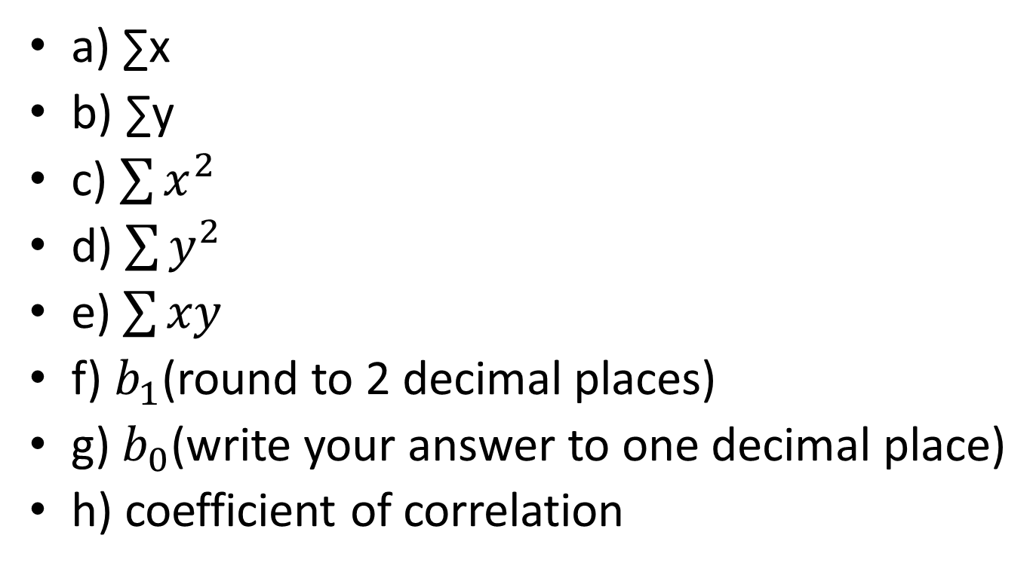
a) ∑x
b) ∑y
c) $\sum{x^{2}}$
d) $\sum{y^{2}}$
e) $\sum{xy}$
f) $b_{1}$(round to 2 decimal places)
g) $b_{0}$(write your answer to one decimal place)
h) coefficient of correlation

